Slide 1
CHAMBER OF ENVIRONMENTAL ENGINEERS UNION OF TURKISH CYPRIOT ENGINEERS AND ARCHITECTS Environmental issues in Northern Cyprus by Doğuç Veysioğlu, Secretary of Chamber, MSc. EnvE.
Notes:
Good afternoon. My name is…
I am environmental engineer specialized in wastewater treatment working at Famagusta municipality
Today, I represent the Chamber of EE. I am the secretary of the chamber
We are going to discuss the environment and environmental problems in northern cyprus. I hope you will enjoy and benefit from it. Please feel free to ask questions along the presentation.
Lets make a short introduction about our Chamber first.
Our chamber currently has approximately 40 members. We are a small chamber operating under the union engineers and architects. We try to advocate environmental protection and management policies in northern Cyprus. Any environmental engineer or those who implement environmental engineering is obliged by law to obtain a licence from us.
After this short introduction I can start my presentation.

Slide 2
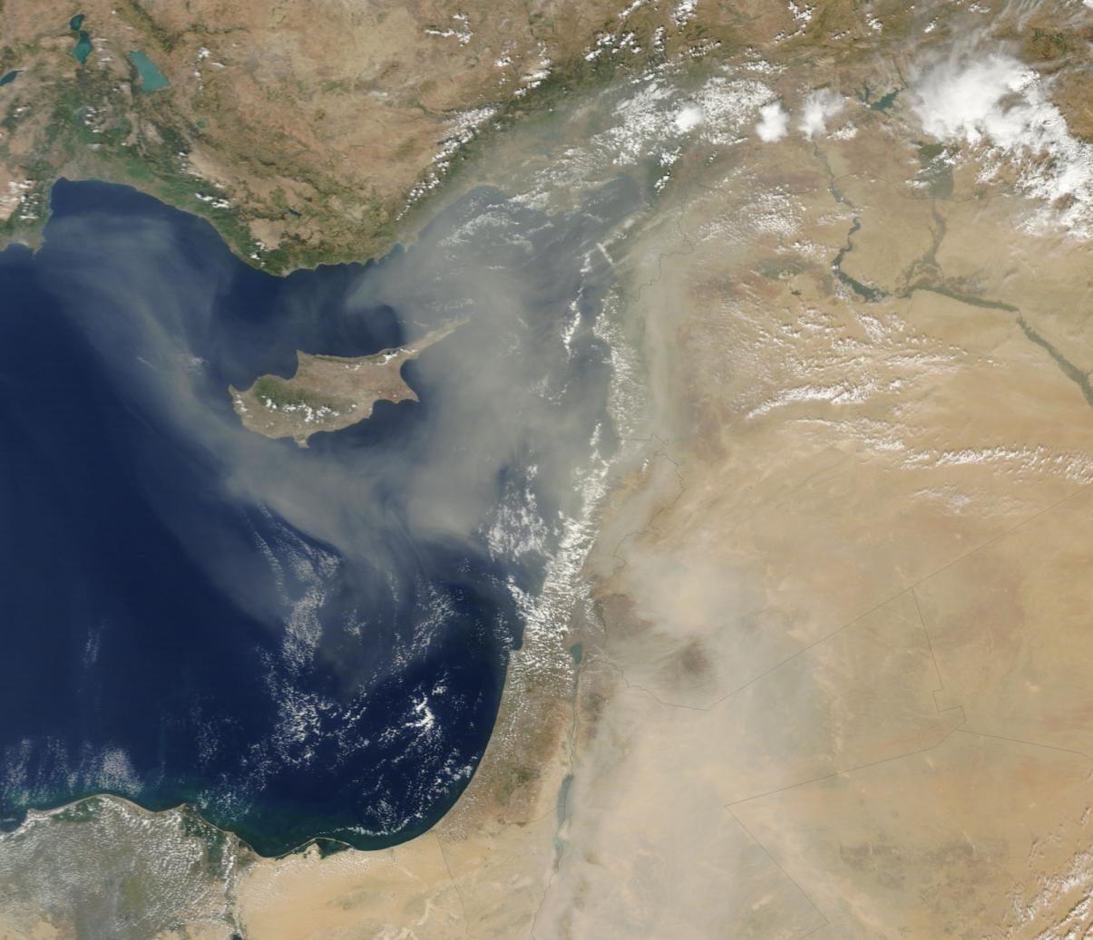
A divided country in Middle East, but its territory is a part of European Union since 2004. European acquis is not in force in the Northern part.
Notes:
Cyprus is an island and a divided country in Middle East since 1974.
Its territory is a part of European Union since 2004 and both communities are considered as European by the EU.
However, European acquis i.e. laws are not in force in the Northern part. North Cyprus has a long road ahead to be able to comply with the european directives. It is also difficult in this political environment to plan the future. Since northern Cyprus is an financially isolated small community, most environmental protection investment are prone to be infeasible. Many issues are related with these facts.

Slide 3
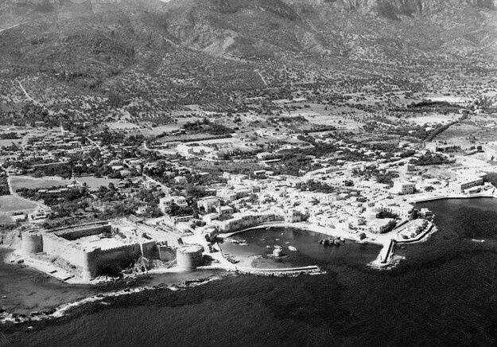
1954
Notes:
Do you recognise this plase?
This was Girne in 1954.
I guess many of you have already been to Girne. I think it is the most beatiful town in the whole island.
I would like to forward another question to you now; What do you think is the basis or beginning of environmental problems?

Slide 4
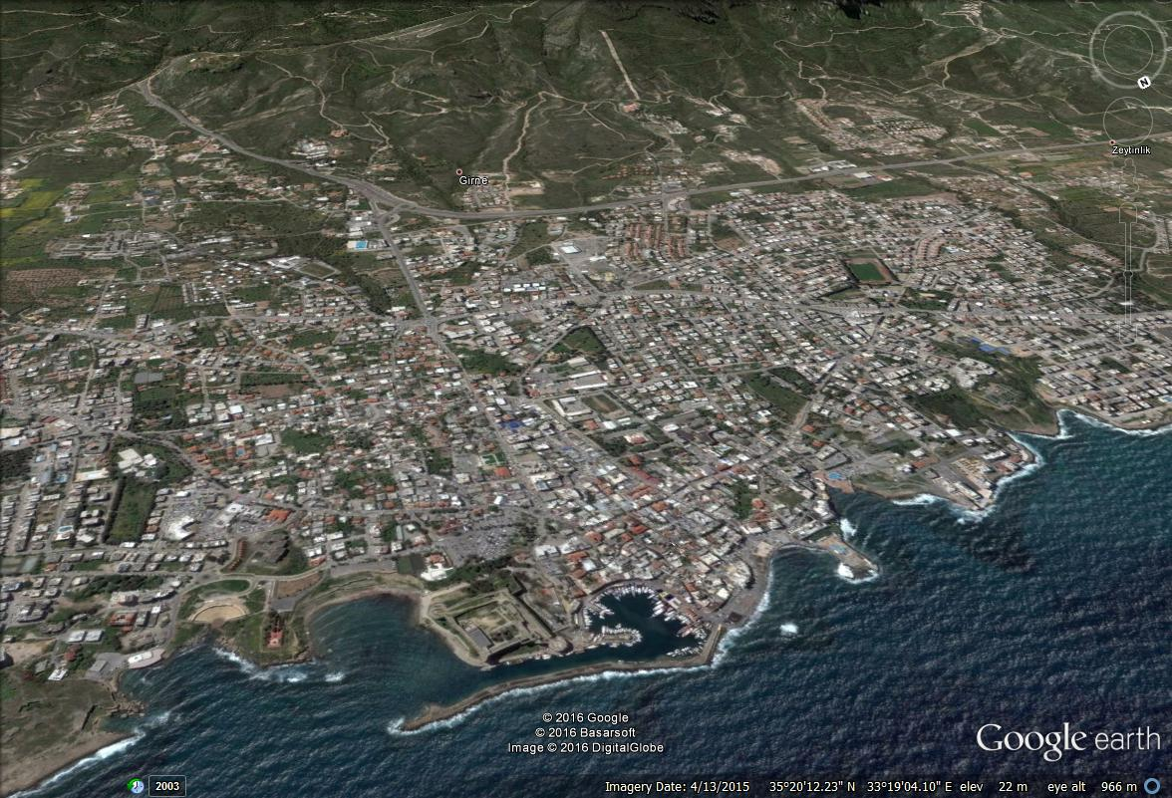
2016
Notes:
The basic answer is random, unplanned, unregulated development.
This is how girne looks in 2016.
Now Girne same as other towns in the whole north Cyprus has many problems and most are related with environment; access to water, wastewater pollution, air pollution due to increased traffic and many other things

Slide 5
Environmental Legislation in N.Cyprus
Over 50 laws related with environmental management and protection. 4 major laws are directly related with environmental protection. These are;
Environment Law 18/2012; aligned with EU acquis
Law on development and zoning 55/89; Orders preparation of a national development plan and individual development plans for cities.
Municipalities law 51/95
Law on establishment, responsibilities and operations of Environmental Protection Department.
Notes:
Lets look at the legislation and major laws that are related with environment in north Cyprus.
There are over 50 laws related with environmental management and protection. 5 major laws are directly related with environmental protection. These are;
Environment Law 18/2012; This law is a very new law that is aligned with EU directives. It requires over 50 secondary laws (tüzük as we call them) to be passed for example for landfilling, strategic environmental impact asessment, urban wastewater treatment. Most of these sendoray laws are mising therefore we can say that the law has many gaps.
Law on development and zoning 55/89; Orders preparation of a national development plan and individual development plans for cities. This law is also not fully in force since only Nicosia has a development plan as a town. For exampe Girne has no development plan and it is governed by ministerial decrees that are susceptible to change with changing cabinets/ministers and decrees have no provisions for spatial planning of town development.
Municipalities law 51/95; Defines how municipalities are established and what their duties are.
Law on establishment, responsibilities and operations of Environmental Protection Department.

Slide 6
Main environmental issues
Water resources management
Urban water supply, wastewater collection, treatment and reuse
Solid waste management
Air quality management
Climate change
Emissions control, environmental permitting, industrial pollution, noise, impact assessment
Development planning, protection of cultural heritage, nature and biological diversity
Notes:
Main environmental issues in the northern part of Cyprus are related with the foundations and basic fields of environmental engineering. These are;
Water resources management
Urban water supply, wastewater collection, treatment and reuse
Solid waste management
Air quality management
Climate change
Emissions control, environmental permitting, industrial pollution control
Development planning, environmental impact assessment, protection of cultural heritage, nature and biological diversity

Slide 7
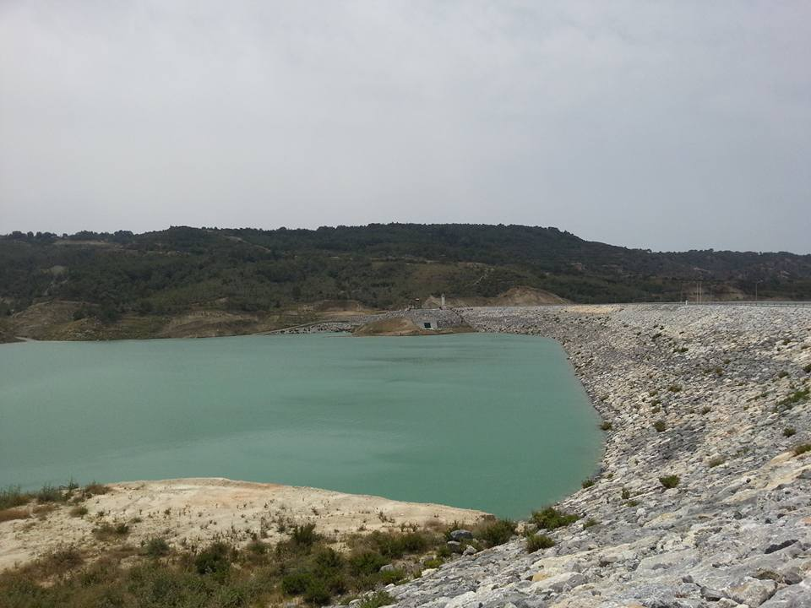
Water resources management
Groundwaters depleting, but we still depend on them
No / very limited surface water, all are exploited and evaporates
Demand is higher than resources: Water budget deificit is around 30-35 mil.m3 per year.
Limited desalination for urban supply; 2 major plants in Mağusa and İskele. Many smaller individual units for hotels and universities.
Importing water from another country – Turkey, 75 mil.m3 per year.
Notes:
Being an island close to Africa and Middle East, Cyprus has an arid climate.
There is no continuously flowing water body. We have to depend on ground water.
The water which is caught by ponds and dams is quickly used together with evaporation. They are all consumed for agricultural purposes.
The current water demand is higher than water resources. Water deficit is estimated to be 30 million cubes per year. The biggest aquifer which is in Güzelyurt, and which is an unconfined aquifer is becoming more saline due to sea water intrusion.
The biggest consumer of water resources is agricultural sector – around 80 million cubes per year. Urban consumption is approximately 30 milyon cubes per year.
Sea water as a water resource is not expoilted efficiently, there are only two small scale desalination plants, one in Mağusa and the other in İskele.
Therefore eventually our government decided to import water from another country

Slide 8
Water supply from Anamur / Turkey
Total length
Funded by Republic of Turkey
Notes:
The plan is to import 75 mil.m3 per year of water from Turkey.
The 160cm diameter PE pipe suspended in marine water approximately 250m sea below water level. Half of this water will be distributed for agricultural use and the other half will be for urban consumption.
According to information received from press, the project costs 1.6 billion TL. It appears that the project is not feasible and strategic benefits are considered in the decision making of project since we are almost sure that the unit cost of water is expensive than that of desalination.
However it is also believed that the investment costs will be subsidized by Republic of Turkey.
This image shows the distribution lines for urban water supply which are almost complete. There is going to be additional inevstments for distribution of irrigation water especially to the Güzelyurt area.

Slide 9
Urban water supply, wastewater collection, treatment and reuse
Drinking water supplied by the central goverment (waterworks department) to municipalities. Urban water supply implemented by 28 municipalities (also responsible for waste collection and disposal). Too many, too disintegrated!
5 major municipalities are served by urban wastewater collection and treatment systems; Lefkoşa, Girne, Gönyeli, Güzelyurt, Mağusa. 23 municipalities are obliged to build collection and treatment systems as per the EU legislation (population equivalent over 2000).
No reuse of treated wastewater available at the moment. Yet, effluent from 3 plants comply with irrigation water standards.
Many individual waste water treatment plants at universities, hotels, private residential areas. EPD has not enough personnel to investigate all. Many operate without permits (effluent quality, reuse conditions are not monitored)
Notes:
By constitution, it is the duty of state to supply adequate water to its citizens. At local level municipalities are responsible to distribute the water coming from the central government, collect and treat wastewater. There are 28 municipalities in North Cyprus. All have separate water, wastewater and waste management services. Financial capabilities of the small community municipalities are very weak. Therefore the quality of services provided by these small municipalities are generally poor. The number of municipalities must either decrease by mergers or the municipalities must cooperate and enhance shared services to increase efficiency.
5 major municipalities have wastewater collection and treatment systems. In total 23 municipalities are obliged to build collection and treatment systems as per the EU legislation (those higher than 2000 population equivalent). Currently there is no urban reuse of treated effluents but 3 treatment plants that are funded by EU complies with irrigation water standards.
There are many small scale package treatment plants owned by universities, hotels and private residential areas. EPD has not enough personnel to investigate all. Many operate without permits meaning effluent quality and reuse conditions are not well known.

Slide 10
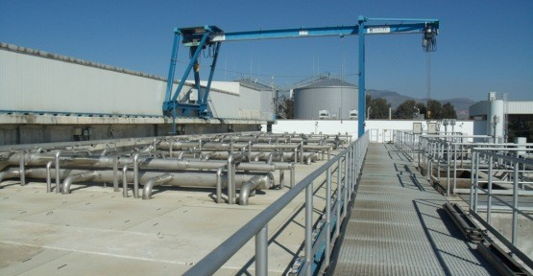
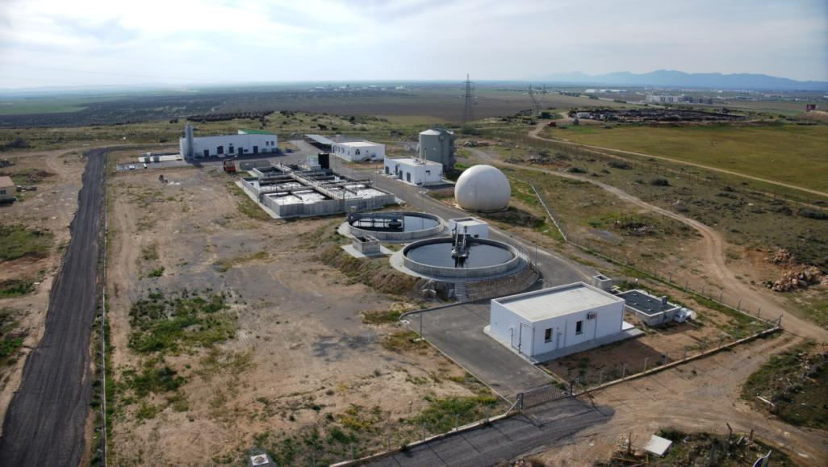
Lefkoşa Bi-Communal WWTP
Mağusa WWTP
Notes:
These are the two biggest wastewater treatment plants in north Cyprus. Lefkoşa WWTP is a bicommunal plant, 70% of the influent comes from south Lefkoşa and 30% from north.
Second pictures shows the Mağusa WWTP, that is where I come from.
Both plants were funded by EU. Effluent quality complies with irrigation water standards.

Slide 11
Solid waste management
18/2012 Environment Law (2nd Chapter on waste management)
By law, municipalities responsible from collection, transportation and disposal of the waste. Ministry of Interior also can make operation.
Dikmen disposal area rehabilitated in 2012. Güngör central landfill opened in 2012 serving 11 municipalities.
More than 50 uncontrolled disposal areas causing soil pollution, water pollution, air pollution, fire, odour, etc.
Waste hierarchy not applied! Almost no recycling, only 4 licensed companies (plastic, paper and cardboard)
Waste composition study had been done in 2006 by EU. waste generation per capita is around 400 kg per year. Population not well known, exact amount of waste does not known.
Waste composition studies must be repeated to investigate feasibility of MBT or other recovery technologies
Notes:
Solid waste management is mainly governed by the Environment law. Municipalities are responsible from collection, transportation and disposal of the waste. Ministry of Interior also can make operation.
There is no integrated waste management approach at the moment. 17 municipalities are still using uncontrolled dumpsites for waste disposal. There are more than 50 uncontrolled dumpsites in north Cyprus. Therefore the exact waste amount is not known. Dikmen which was the biggest dumpsite in the past now closed and Güngör sanitary landfill which complies with the landfill directive of EU is now serving 11 municipalities. According to waste master plan prepared in 2006, Güngör is designed to serve whole north Cyprus. The unit waste generation rate is approximately 400 kg per person per year. Waste composition study is necessary to investigate feasibility of an MBT plant.
Ülkenin hemen her yanında bulunan çöp alanlarının kapatılması, katı atık politikasının reel olarak uygulanması . Atıkların kaynağında ayrıştırıldığı, yeniden kullanıldığı veya geri dönüşüm tesislerinin olduğu, düzgün ve düzenli işletilen Güngör katı atık depolama sahası için gerekli olan tüm iyileştirmelerin yapılması..

Slide 12
Notes:
This is a simple figure of standard sanitary landfill crossection. This is compulsory according to the EU landfill directive and it was applied in rehabilitation of Dikmen dumpsite and construction of new central santiray landfill Güngör.

Slide 13
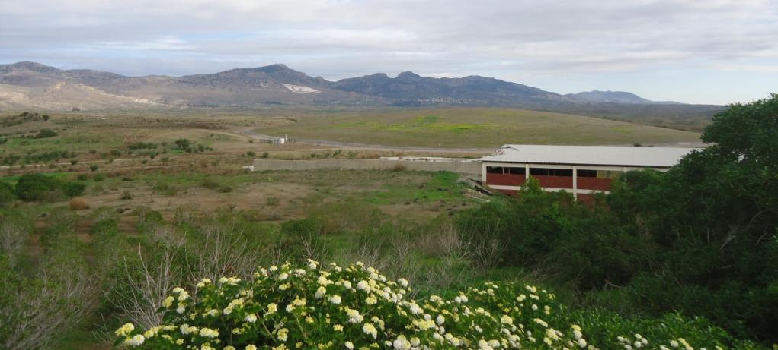
Dikmen Dump: Before & After Rehabilitation

Slide 14
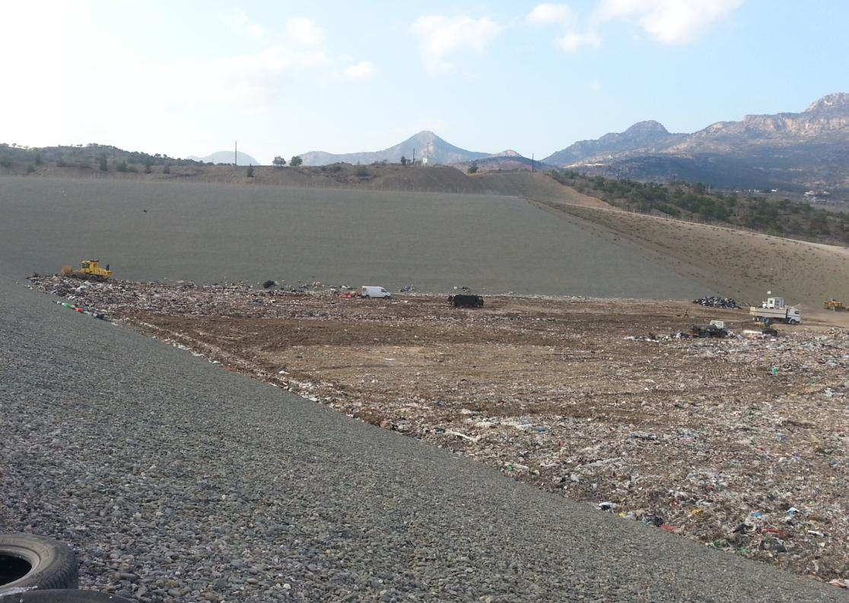
Güngör Landfill

Slide 15
Air quality & climate change
Major pollutants; PM10, SO2, NH3, NO2, VOC - ozone depletion and formation
Sources of pollutants; Main source is fossil fuel burning – heating, electricity, transportation
Pollutants that are over the limits stated in two EU directives – 2008/50/EC, 2004/107/EC
PM10: Over the limits. Man-made causes are traffic, construction sites, natural dust from Africa, open areas, lack of vegetation/green cover
SO2: Over the limits at hot spots and near point sources; Lefkoşa and Girne traffic, stack gas emissions from two major power plants
NO2: Not over the limits but close. Measures are needed to reduce stack gas emissions to meet EU targets.
Climate change: No measures, no national policy. International pressure non-existent. Promote public transport and use of renewable energy, increase forest tree population
Notes:
Air quality management and global climate change prevention are related fields.
According to EU directives major air pollutants are PM10, SO2, NH3, NO2, VOC which leads to ozone depletion and formation. Fossil fuel burning is the main source of these pollutants. Fossil fuels are burnt for heating, electricity generation and transportation
In our circumstance;
PM10 is over the limits especially in big cities like Lefkoşa and Girne. Man-made causes are traffic, construction sites. Natural causes are dust from Africa, open undeveloped areas, lack of vegetation and green cover.
SO2 is over the limits at hot spots and near point sources; Lefkoşa and Girne traffic, stack gas emissions from two major power plants
NO2 is currently not over the limits but we are close to target limit near point sources. Measures are needed to reduce stack gas emissions to meet EU targets.
Climate change: There is no national policy. International pressure is non-existent. Even in countries like USA it is a controversial subject.
Promote public transport, use of renewable energy and increase forest tree population to help prevent global warming

Slide 16
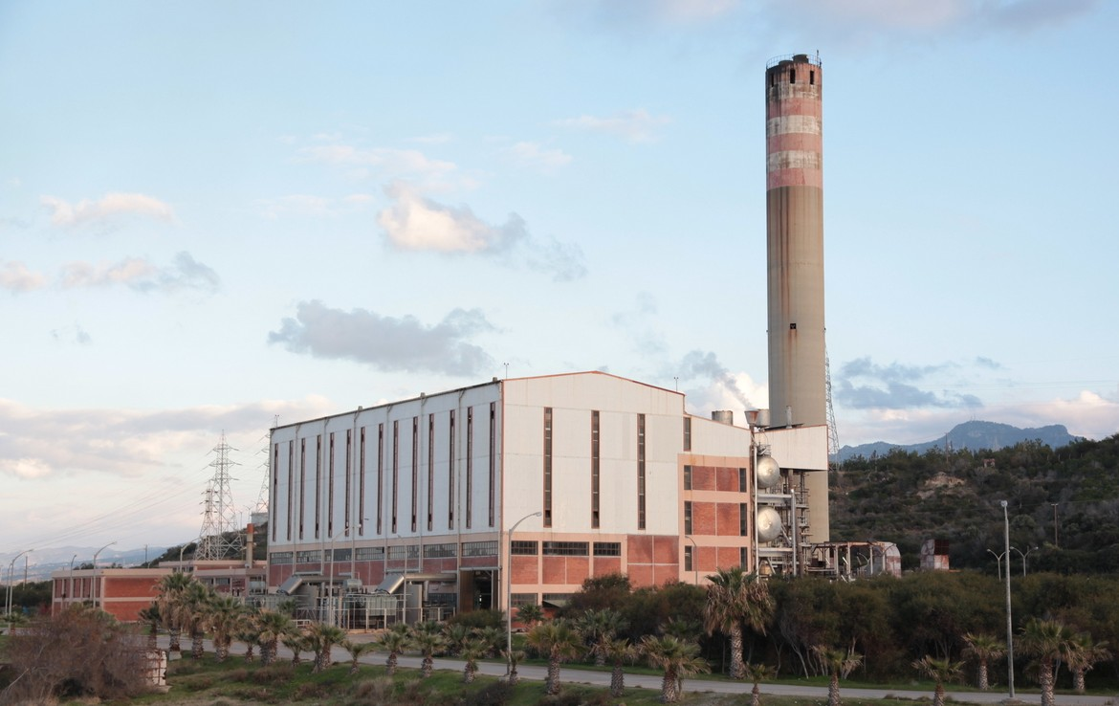
Industrial emissions and environmental permitting
Legislation is missing for regulation of industrial emissions and permits
Teknecik Power Plant: 261 MW capacity, fuel oil fired. There is no stack-gas treatment. NOx, SOx emission, PM over EU emission target limits.
Kalecik Power Plant: 148 MW capacity, fuel oil fired. There is stack-gas treatment but it has problems.
Cyprus Mining Co. (CMC), Lefke: Copper Mine, 9.5 million tons hazardous waste in area of 1.5 km2 since 1974. Heavy metal contamination in ground water and soil.
Quarries: ~35 quarries. Permit conditions are non-existent / weak. Rehabilitation programs missing. PM emission, damage to flora –fauna, noise pollution, etc.
Notes:
The legislation for regulation of industrial emissions and permits is missing. Therefore most of the biggest industrial establishments operate wthout permits and we do not know under which conditions they are operating or what will happen for example when they are closed down.
In the previous slide I mentioned that we have two power plants. These do not have proper stack gas treatment systems.
The other problematic industrial sector is mining and quarrying. CMC is an abondened copper mine in Lefke with 9.5 million tons of hazardous waste which leads to heavy metal contamination in groundwater and soil.
There are 35 quarries that are mainly located on beşparmak mountains also operating without permits and rehabilitation programs.

Slide 17
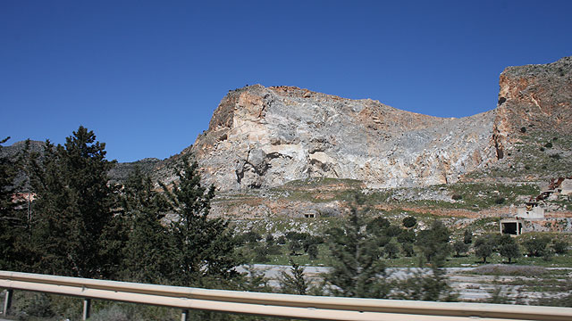
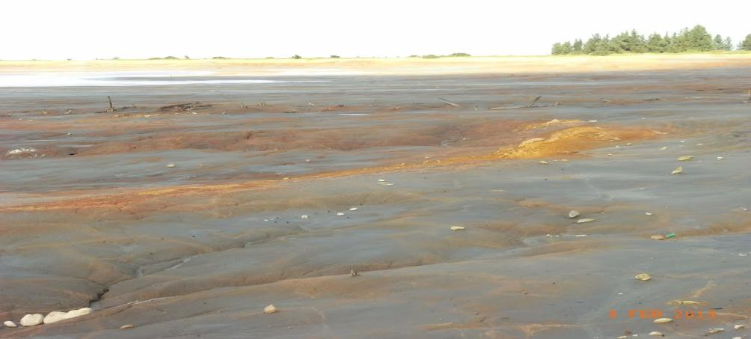
A quarry in Beşparmak
CMC Pit

Slide 18
Horizontal issues; development planning, protection of cultural heritage, nature and biological diversity
Only Nicosia has a comprehensive development plan as a town. Spatial development in 4 major cities (districts) not regulated; Girne, Mağusa, Güzelyurt and İskele
99/2014 Protection of Flora – Fauna Birds Legislation is in force.
7 special environmentally protected areas (potential Natura2000 sites) are defined but their management plans are missing.
Strategic environmental assessment (SEA) regulation has not yet been passed. SEA is not implemented for large scale projects and strategies.
EIA regulation has considerable gap. Some projects are exempt from EIA
Notes:
Development planning, protection of cultural heritage, nature and bio-diversity are horizontal issues that are related with protection of environment.
In the beginning of my presentation I mentioned what happened to Girne because of unplanned development. In north Cyprus, only Nicosia as a town has a comprehensive development plan.
Protection of Flora – Fauna Birds Legislation recently came into force in 2014.
There are 7 environmental protection areas but their management plans are still not prepared.
Even, bird hunting is still allowed and very common in these areas.
Stratgic environmenal assessment procedure does not exist. So large scale projects such as construction of a new highway, airport, harbor, large scale pipeline project such as Turkish water project etc always become controversial matters. Public participation and consultation procedures are generelly missing.
Environmental impact assessment regulation is in force but it has considerable gap and some developers can invent intelligent ways to avoiding EIA reports.

Slide 19
Nuclear power plant in Akkuyu, Mersin
To be built over high earthquake risk area / fault line and to be operated by Russian Federation
In case of an accident, Cyprus will be affected more than Mersin
No international communication / negotiation with neighboring countries
Nuclear waste is supposed to be transferred to Russia via sea route.
Notes:
Apparently, it is probable that we are going to have another environmetal problem in future. That is the nuclear power plant in Akkuyu, Mersin. Republic of Turkey is planning to build a nuclear power plant right over a high earthquake risk area and in case of an accident Cyprus will be affected more than Mersin beacuse of its proximity. There has been no international negotiation with neighboring countries. As you already know, there is no technology for recovering or safely disposing nuclear waste and they are stored eternally. It is stated that the nuclear waste will be transported to Russia from the sea via Istanbul Bhoshporus.

Slide 20
Thank you! Questions?
Notes:
With this short presentation and time I tried to cover all envrionmental problems and fields of environmental engineering.
Thank you for your attention. I can receive questions. If anybody would like to open a discussion we can do that if we still have time.

